Slide 1



Nhot – help you read and write in twitter
Wechat：Silv3rH4nd

Slide 2

What Nhot try to do?
Too many twitter to read?
Nhot Combine a large number of tweets into one.
You can choose a specific Twitter user, and we can help you summarize their tweets.

Slide 3

What Nhot try to do?
2.Donot know what to say?
Nhot Help you speak your mind freely.(you can be anyone)
You can become Ma Yun, Trump or Lu Xun by changing the file character.

Slide 4
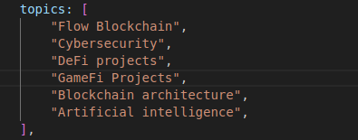
What Nhot try to do?
3. Search for keywords on a specific topic and comment.

Slide 5
What Nhot try to do?
3.Even be a kol
Nhot help you be kol more easy.but…

Slide 6
What will Nhot do next
Flow has a powerful plugin store, opening doors for innovation. Imagine we launch a special plugin there in the future. This plugin allows easy publication of promotion tasks. Once participants draw significant traffic, they'll get Flow points as rewards.

